Slide 1
RE – X86 ASM (32bit)
Presented by Christopher Doege

Slide 2
Intel Vs AT&T: The Great Debate
Intel
Infers data sizes from source register
Utilizes DWORDs to calculate relative offsets
Flow of code
Instruction dest, src
dest ← src
AT&T
Utilizes letters on the end of instructions to infer size
I.E. movb, movl, etc
Utilizes the position of registers to calculate relative offsets
Flow of code
Instruction src, dest
src → dest

Slide 3
Which One Should You Use?
AT&T is predominately on Linux
Intel is predominately on Windows
Windows dominates the market, therefore most static analysis tools utilize Intel syntax (Bninja, IDA, etc)

Slide 4
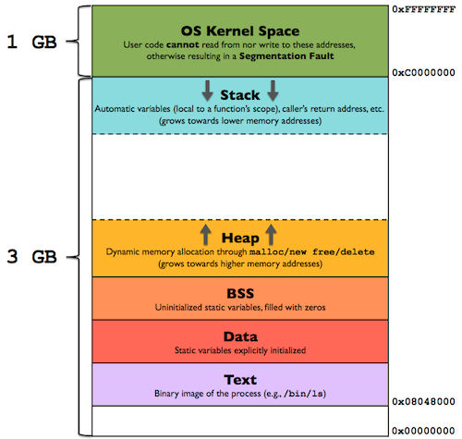
Program in Memory View 1

Slide 5
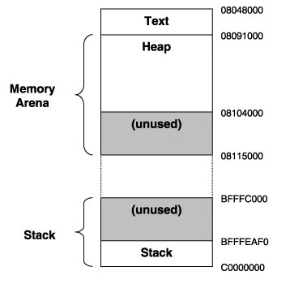
Program in Memory View 2

Slide 6
What you’re going to learn
#include <stdio.h>
int main(){
printf(“Hello World!\n”);
return 0x1234;
}
6
Notes:
6

Slide 7
Is the same as…(Windows)
.text:00401730 main
.text:00401730 push ebp
.text:00401731 mov ebp, esp
.text:00401733 push offset aHelloWorld ; "Hello world\n"
.text:00401738 call ds:__imp__printf
.text:0040173E add esp, 4
.text:00401741 mov eax, 1234h
.text:00401746 pop ebp
.text:00401747 retn
7
Notes:
7

Slide 8
Is the same as…(Linux)
08048374 <main>:
8048374: 8d 4c 24 04 lea 0x4(%esp),%ecx
8048378: 83 e4 f0 and $0xfffffff0,%esp
804837b: ff 71 fc pushl -0x4(%ecx)
804837e: 55 push %ebp
804837f: 89 e5 mov %esp,%ebp
8048381: 51 push %ecx
8048382: 83 ec 04 sub $0x4,%esp
8048385: c7 04 24 60 84 04 08 movl $0x8048460,(%esp)
804838c: e8 43 ff ff ff call 80482d4 <puts@plt>
8048391: b8 2a 00 00 00 mov $0x1234,%eax
8048396: 83 c4 04 add $0x4,%esp
8048399: 59 pop %ecx
804839a: 5d pop %ebp
804839b: 8d 61 fc lea -0x4(%ecx),%esp
804839e: c3 ret
804839f: 90 nop
8
Notes:
8

Slide 9
Is the same as…(OSX)
_main:
00001fca pushl %ebp
00001fcb movl %esp,%ebp
00001fcd pushl %ebx
00001fce subl $0x14,%esp
00001fd1 calll 0x00001fd6
00001fd6 popl %ebx
00001fd7 leal 0x0000001a(%ebx),%eax
00001fdd movl %eax,(%esp)
00001fe0 calll 0x00003005 ; symbol stub for: _puts
00001fe5 movl $0x00001234,%eax
00001fea addl $0x14,%esp
00001fed popl %ebx
00001fee leave
00001fef ret
9
Notes:
9

Slide 10
X86 Registers
Registers are small memory storage areas built into the processor (still volatile memory)
8 “general purpose” registers + the instruction pointer which points at the next instruction to execute
But two of the 8 are not that general
On x86-32, registers are 32 bits long

Slide 11
X86 Register Cont…
EAX – Return value
EBX – Generic / general purpose, Data Base
ECX – Loop count, param
EDX – Params, Data, Math, I/O
ESI – Source Index (Also used in strings)
EDI – Destination Index (Also used in strings)
EBP – Base Pointer (Start of the stack frame)
ESP – Stack Pointer (End of the stack frame)
EIP – Instruction Pointer
EFLAGS – Flags register

Slide 12
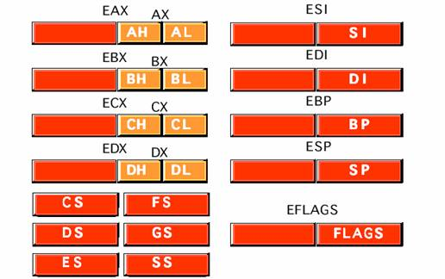
X86 Register Cont…

Slide 13
X86 Flags (Important Ones)
CF – Carry Flag: Used in arithmetic to determine if a bit change has occurred out of the MSB
OF – Overflow Flag: Used to determine a change out of MSB in signed arithmetic.
SF – Signed Flag: Used in arithmetic to determine if the MSB is 1 in last operation.
ZF – Zero Flag: Used in arithmetic to tell if the result is 0.
TF – Trap Flag: Enables debuggers to single step through a program.
PF – Parity Flag: Determines if bits are odd or even. Used in Decimal math.

Slide 14
X86 Registers Cont…
Caller-save registers - eax, edx, ecx
If the caller has anything in the registers that it cares about, the caller is in charge of saving the value before a call to a subroutine, and restoring the value after the call returns
Put another way - the callee can (and is highly likely to) modify values in caller-save registers
Callee-save registers - ebp, ebx, esi, edi
If the callee needs to use more registers than are saved by the caller, the callee is responsible for making sure the values are stored/restored
Put another way - the callee must be a good citizen and not modify registers which the caller didn’t save, unless the callee itself saves and restores the existing values

Slide 15
First Instruction
NOP - No Operation! No registers, no values, no nothin’!
Just there to pad/align bytes, or to delay time
Bad guys use it to make simple exploits more reliable
Trivia:
“The one-byte NOP instruction is an alias mnemonic for the XCHG (E)AX, (E)AX instruction.”

Slide 16
The Stack
The stack is a conceptual area of main memory (RAM) which is designated by the OS when a program is started.
Different OS start it at different addresses by convention
A stack is a Last-In-First-Out (LIFO/FILO) data structure where data is "pushed" on to the top of the stack and "popped" off the top.
By convention the stack grows toward lower memory addresses. Adding something to the stack means the top of the stack is now at a lower memory address.

Slide 17
The Stack Cont…
As already mentioned, esp points to the beginning of the stack, the lowest address which is being used
While data will exist at addresses beyond the top of the stack, it is considered undefined
The stack keeps track of which functions were called before the current one, it holds local variables and is frequently used to pass arguments to the next function to be called.
A firm understanding of what is happening on the stack is *essential* to understanding a program’s operation.

Slide 18
Push & Pop
Push
Saves a register onto the stack
The push instruction automatically decrements the stack pointer, esp, by 4
Pop
Retrieves a register from the stack
The pop instruction automatically encrements the stack pointer, esp, by 4

Slide 19
Call – Call Procedure
CALL’s job is to transfer control to a different function, in a way that control can later be resumed where it left off
First it pushes the address of the next instruction onto the stack
For use by RET for when the procedure is done
Then it changes eip to the address given in the instruction
Destination address can be specified in multiple ways
Absolute address
Relative address (relative to the end of the instruction)

Slide 20
Ret – Return from Procedure
Two forms
Pop the top of the stack into eip (remember pop increments stack pointer)
In this form, the instruction is just written as “ret”
Typically used by cdecl functions
Pop the top of the stack into eip and add a constant number of bytes to esp
In this form, the instruction is written as “ret 0x8”, or “ret 0x20”, etc

Slide 21
MOV - Move
Can move:
register to register
memory to register, register to memory
immediate to register, immediate to memory
Never memory to memory!
Trivia:
The mov instruction has been proven to be Turing complete

Slide 22
Other MOV Operations
MOVSX
Sign extended mov, utilized when moving data from smaller to higher registers
MOVZX
Zero Extended move, utilized for unsigned operations where the sign does not want to be preserved

Slide 23
LEA - Load Effective Address
Frequently used with pointer arithmetic, sometimes for just arithmetic in general
Example: ebx = 0x2, edx = 0x1000
lea eax, [edx+ebx*2]
eax = 0x1004, not the value at 0x1004

Slide 24
ADD and SUB
Adds or Subtracts, just as expected
Destination operand can be r/m32 or register
Source operand can be r/m32 or register or immediate
No source and destination as r/m32s, because that could allow for memory to memory transfer, which isn’t allowed on x86
Evaluates the operation as if it were on signed AND unsigned data, and sets flags as appropriate. Instructions modify OF, SF, ZF, AF, PF, and CF flags
add 8, ebp
sub eax, [ebx*2]

Slide 25
XOR – Exclusive OR
Performs XOR option on two register
Commonly utilized to zero out a register:
XOR eax, eax
Effectively zeros out EAX. Cheaper than moving 0 intel eax.
Also utilized in various forms of arithmetic, bit flips and encryption

Slide 26
General Stack Frame Operation
Stack beginning
Local Variables
main() frame
undef
undef
…
stack end

Slide 27
General Stack Frame Operation Cont..
stack bottom
Local Variables
Caller-Save Registers
Arguments to Pass to Callee
Caller’s saved return address
Saved Frame Pointer
Callee-Save Registers
Local Variables
main() frame
foo()’s frame
undef
…
stack top
27

